Slide 1
Scenario
The year is 2015, I work for a gaming startup. The leadership team has asked me to answer the question; what game can we make with the highest likelihood of selling more than average coming into 2016?
Hypothesis
I believe creating a shooter genre game targeted towards a North American audience will sell the highest number of units and perform better than an average game.

Slide 2
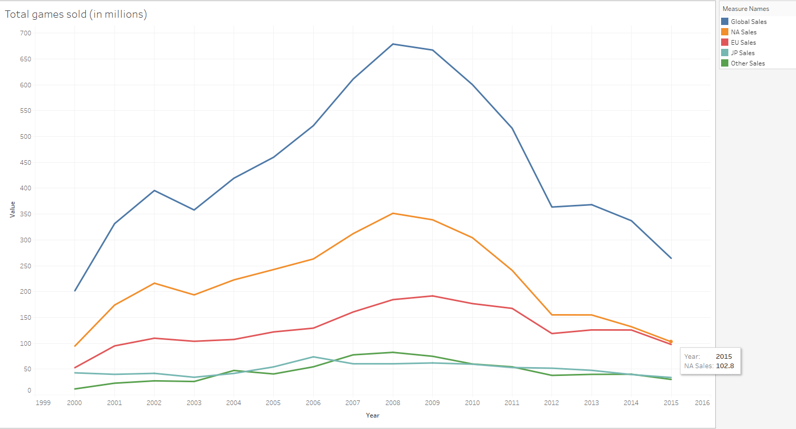
NA has the highest total sales overall and in the last year out of all the regions.
Key takeaway is we should target a North American audience because they buy the most games.

Slide 3
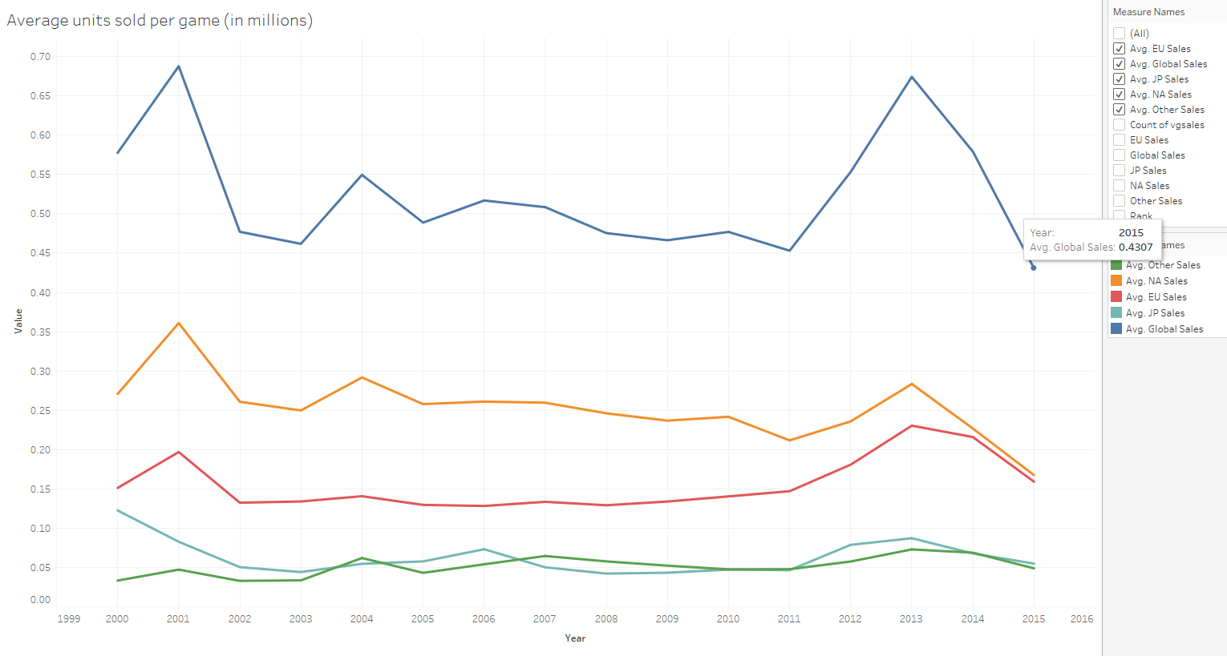
Average units sold per game is still highest in North America.
The data also shows the average game sold 430,000 copies on average globally.
Key takeaway is sell more than 430,000 copies as a goal.

Slide 4
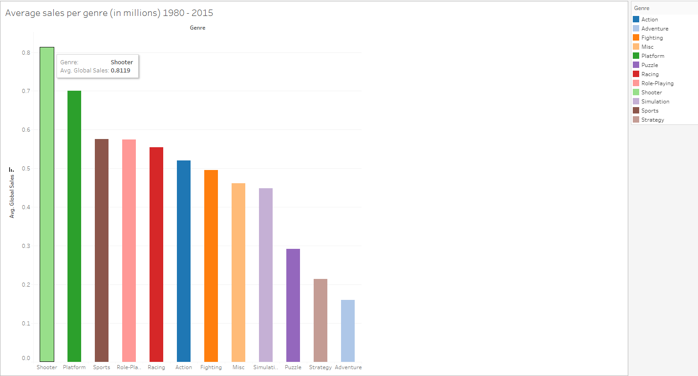
The shooter genre had the highest overall average global sales based off the total average from 1980 to 2015 taken from 15,979 total games.
Key takeaway is create a game in the shooter type genre.

Slide 5
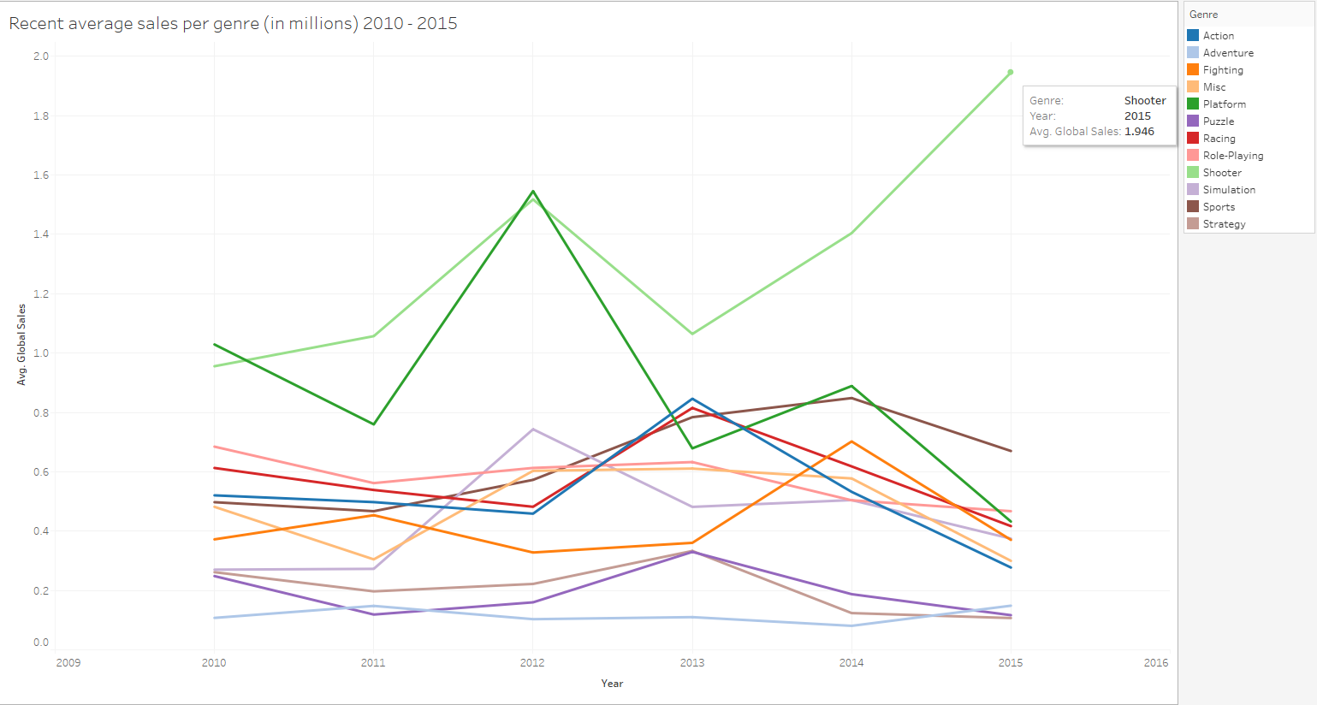
The chart shows that the shooter genre has been the most popular in terms of average sales per game even recently and is showing a boom in popularity.
Key takeaway is create a game in the shooter type genre, with the decision further supported by recent sales data.

Slide 6
Conclusion
Based off the data provided ranging from 1980 – 2015 and recent trends the company should look to create a Shooter genre type game and target a North American audience.
The company can expect the game to sell 2 to 4 more times as many copies as the average game by creating a shooter.

Slide 7
Data set
https://www.kaggle.com/datasets/gregorut/videogamesales/data

